Slide 1
Text area extraction
By: Muntean Cristian
Coordinating Professor: Varga Robert

Slide 2
Description of the project
The aim of the project is to correctly rotate a photo of a multiple-choice exam paper and extract the regions of text.
This was done in two steps:
Rotate the image such that the exam sheet is vertical and remove the background objects if a background is present.
Detect the areas in the picture where text is present and extract them in multiple images.

Slide 3
Input/output of the application
The application receives as input an image of an exam paper, which can be rotated or not.
The output of the application is a set of images that correspond to the areas in the input that contain text.
The input image has the following constraints:
The sheet of paper must the biggest object in the picture if there is a background present
The sheet of paper, if rotated, must be have an angle that is between (-90, 90) degrees from its correct vertical position.

Slide 4
Related work and research – background removal
My main source of documentation was stackoverflow
Other people have tackled the problem of detecting a sheet of paper in an image in various ways:
By converting the image into grayscale, applying a median filter, followed by a dilation, an erosion and finishing with a binarization using Otsu. After that, the largest contour remaining should be the page.
By converting the image into HSV, thresholding the S channel and getting the largest contour.

Slide 5
My approach
In my case, I found that the first method produced significantly better results that the second one. However, because some of the examples I provided contained a sheet of paper which had its cropped and the background had both dark and light areas, the biggest contour was not the sheet of paper
To fix this, I created a mask, which kept only the piece of paper and removed the whole background. From there, I found the angle of rotation of the sheet of paper with the vertical axis by rotating the mask of the page and finding the version of the rotated page which had the smallest width and biggest height out of all of them.

Slide 6
Related work and research – text area extraction
With the sheet of paper rotated and background removed, the next step was to extract the text areas
The main method I found included the binarization of the image, followed by a dilation in width and an erosion and finding the connected components contours. The last step was to enclose each contour found that had a width bigger than height.
This method was also found on stackoverflow

Slide 7
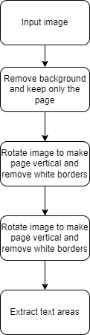
General approach and high-level architecture
As previously mentioned, the flow of the application contains two major steps:
Isolate the page and make it vertical
Extract the areas containing text
The first step also consists two steps:
Remove the background from the original image
Rotate the page to make it vertical and remove the white borders

Slide 8
Implementation details
The most important parts of the project are:
Removing the background
Finding the angle of rotation
Finding the areas of text

Slide 9
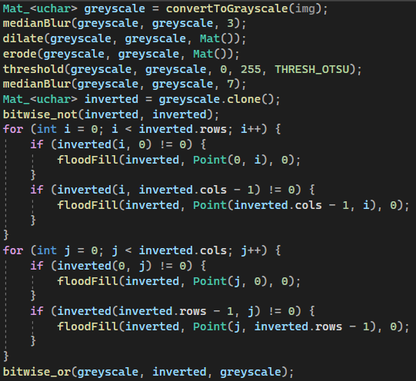
Removing the background – Part 1
To remove the background, a mask of the page was needed, which would later be used to remove everything else from the image except the page.
The image is converted to greyscale. Then, a median blur is applied to enhance the edges, followed by a dilation and erosion to remove some of the existing noise. Next, the greyscale image is binarized using Otsu thresholding algorithm and a median blur is applied again to remove the pieces of text within the page.
The binarized image is then inverted to make the page black and a black flood fill is applied from each point along the edges if it is not already black. This flood fills will make everything black except the large elements that are inside the page.
After that, the original binarized image and the image which contains only the large elements inside the page are combined using a bitwise OR operation. This leaves makes the page fully white.

Slide 10
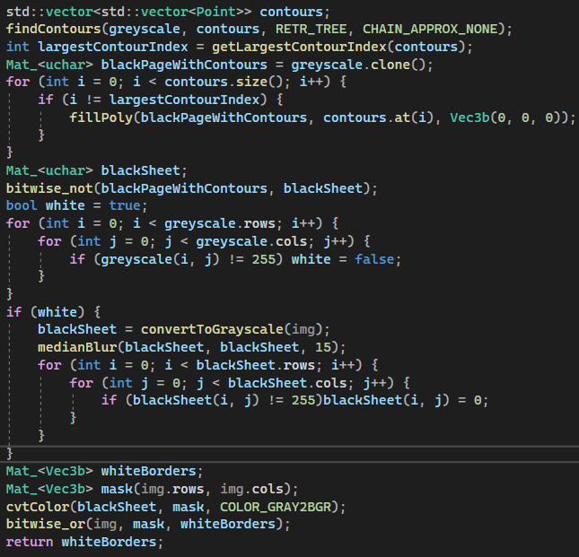
Removing the background – Part 2
Next, all the contours are taken and the largest one is kept. All the other ones are filled with black. This will result in an image where only the sheet of paper will be white, and the rest of the image is black.
The image is inverted such that the sheet of paper is black and the rest is white. This will result in a mask of the piece of paper.
If there is a white background, the mask is fully white. In this case, the mask is created by converting the original image to grayscale, applying a median blur and everything that is not white will be the page.
The page without background will be the bitwise OR between the original image and the mask of the page.

Slide 11
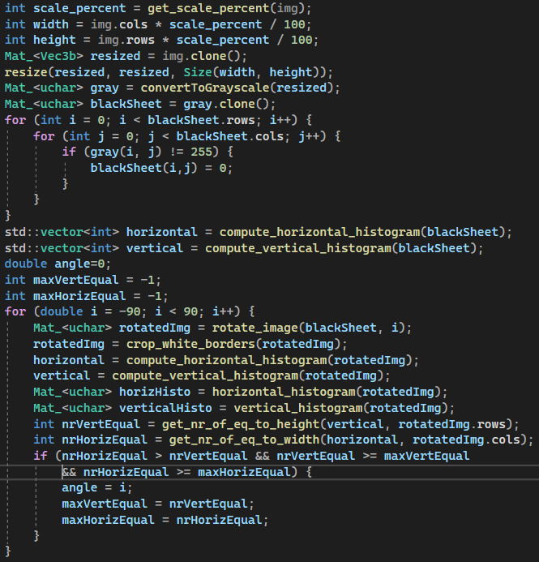
Finding the angle of rotation
First the image is resized for the following operations on the image to be faster
Next the resized image, which now contains only the sheet of paper with a white background, is converted such that the sheet of paper becomes black.
The black paper is then rotated from -90 degrees to 90 degrees and on each rotation the horizontal and vertical histogram is computed.
For each histogram, the number of values that are close to the width and height are counted
The rotation angle is the one with the maximum number of values from the histograms which are close to the width and height of the image

Slide 12
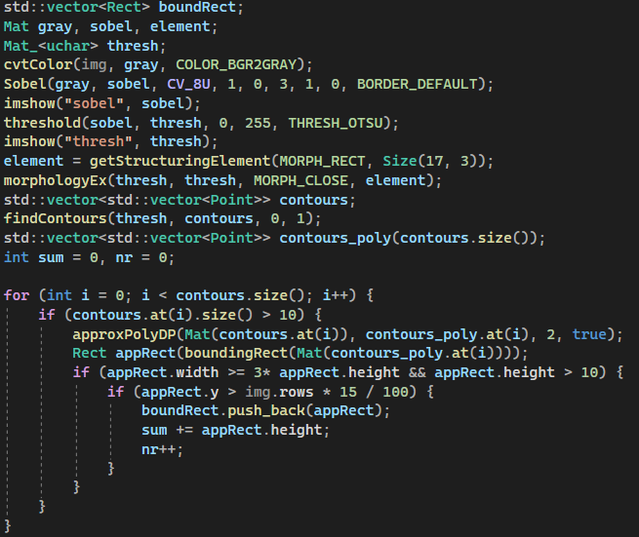
Finding the areas of text
The rotated image is converted to greyscale, then Sobel is applied in order to keep only the edges, followed by binarization using Otsu.
On the binarized image, a closing operation with a short and wide kernel is performed to create solid objects out of the written text.
All the contours are found and the ones that have their width greater than 3 times the height and the height is at least 10 pixels are recorded. The average height of the elements that are not in the top 15% of the page and the ones that have more than 1.4 times that are split in half.
The splitting was done to separate rows that are connected by thin lines
All the contours are gathered again after the splitting

Slide 13
User manual
In order to run the application, the user must place the images he wants to extract the text areas from into the folder of the project.
Then, before running the application, the user must provide the path of the image in the first line of the main function.
By running the application, the use is able to see the original image, the rotated image, the image that contains bounding boxes for all of the text areas and every text area in part.
Also, each text area that is extracted is saved in a folder named “Extracted text”, that is present at the same level in the project source code.

Slide 14
Results
By running the application on the provided examples, it is clearly seen that the page is correctly recognized, rotated, and the background is removed.
Also, areas of text are correctly extracted and saved for further processing

Slide 15
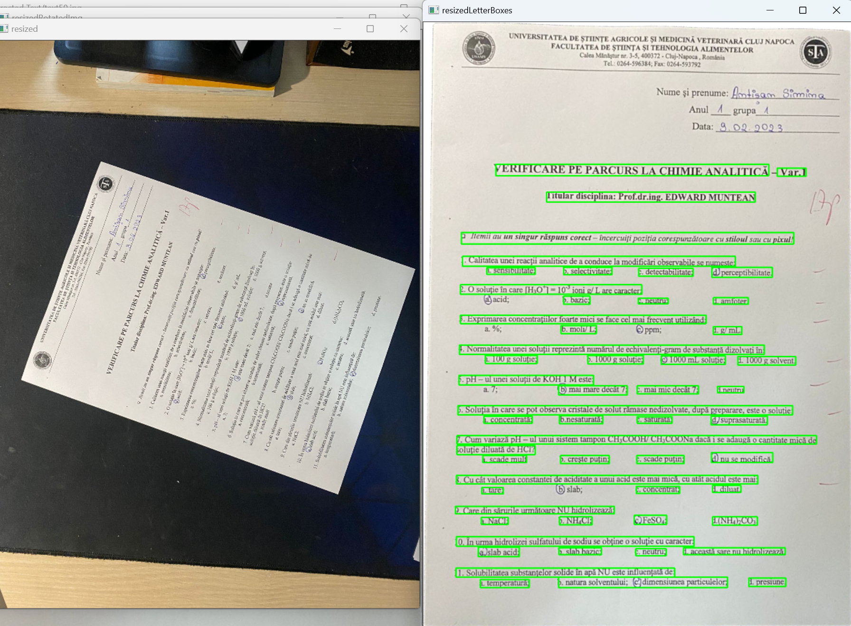
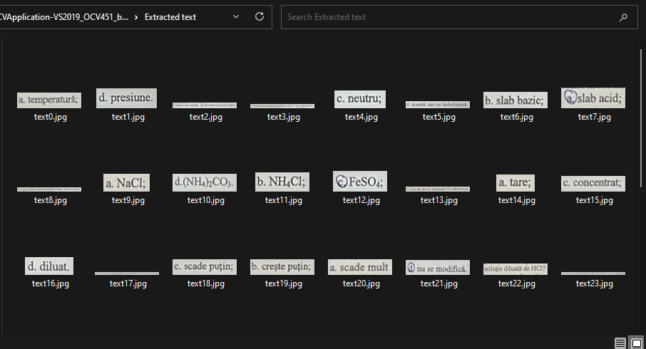

Slide 16
Conclusions
In the provided results it can be seen that the header of the page is not taken into account.
This is because the application is meant to extract text from a multiple-choice exam paper, thus the header is not part of the questions or answers of the exam.
Some further development is possible. In order to not scramble the responses and the questions, a new text area can be created, which contains the question text area and its possible responses.
This can be done by merging close objects and generating bigger and fewer text areas, which are further split into the text areas which are currently shown and save each question together with its corresponding answers separately.
In this way, we can keep track of the questions and its responses and feed them separately in a neural network designed to “read” text.

